Slide 1
Dynamic Remaining Useful Life (RUL) Prediction for LFP Batteries with Conformal Uncertainty Quantification
Name: R S Chandramohan
Branch: ECE | Year of Study: 4th Year
College: Sastra Deemed to be University, Thanjavur

Slide 2
What is RUL & Why is it Critical?
What is RUL?
Remaining Useful Life is the exact number of charge/discharge cycles remaining before an EV battery degrades to its end of life retirement threshold (80% State of Health).
Why is it Needed?
EV drivers constantly face 'Range Anxiety' and sudden battery failures. Traditional BMS only measure current state, they can't warn drivers when the battery will permanently fail.
What We're Doing
We're building a Dynamic AI Predictive Dashboard that continuously monitors vehicle sensor data while driving, forecasting the exact remaining lifespan and providing a mathematically guaranteed worst-case safety warning window.

Slide 3
Problem Statement & Industrial Need
Overcoming Blind Single-Point AI Predictions in Electric Vehicle BMS
The Automotive Problem: Standard EV battery systems assume capacity fades in a linear straight line. In reality, lithium-ion cells suffer a sudden, dangerous 'capacity plunge' right near the end of their life.
Why Normal AI Fails: Standard machine learning gives a blind single guess without any safety warning or confidence bounds. If that guess is wrong by even 50 cycles, a driver can get stranded with a dead car.
Our Industrial Solution: A dynamic tracking dashboard that polls vehicle telemetry every 5 cycles while driving, combining regularized LightGBM decision trees with physical electrical equations and a guaranteed 90% Conformal Prediction safety window.

Slide 4
Base Paper Comparison & Our Core Contributions
Base Benchmark Paper: Severson et al., 'Data-driven prediction of battery cycle life before capacity degradation', Nature Energy (2019).
Base Paper Limitation: They took a single static snapshot of early life (Cycles 10–100) and made one lifetime guess. It could never update again while driving if thermal stress accelerated.
Our Improvement 1 - Dynamic Real-Time Tracking: We poll telemetry checkpoints every 5 cycles to continuously update remaining lifespan while driving.
Our Improvement 2 - Guaranteed Safety Margins: Instead of a raw guess, we provide a 90% Conformal Prediction safety bracket giving a known worst-case maintenance window.
Our Improvement 3 - True Unseen Validation: We used Grouped Leave-Cells-Out validation so the AI is tested on completely hidden EV batteries.

Slide 5
Dataset Specifications & Engineering Assumptions
Stanford / MIT / Toyota Research Institute Benchmark Dataset
Battery Cell Specs: 124 physical A123 Systems APR18650M1A Lithium Iron Phosphate (LFP) cylindrical cells (18 mm x 65 mm).
Nominal Ratings: Capacity = 1.1 Ah; Voltage = 3.3 V (Operating range: 2.0 V to 3.6 V).
Testing Conditions: Continuous fast-charging (1C to 6C rates) inside 30°C thermal chambers until 80% State of Health (0.88 Ah).
Unseen Test Cell Identity: In our trajectory and control plots, we specifically highlight Unseen Test Cell '2017-05-12_cell_12' as our real-world validation proof.
Assumption 1 - 1st-Order Circuit Dominance: We assume a 1-resistor/1-capacitor equivalent circuit captures >95% of dynamic voltage response without lagging microchips.
Assumption 2 - Normalized Size Invariance: By measuring capacity as a percentage (SOH = Q / Q_nom), our aging rules apply equally to 1.1 Ah lab cells and large 100 Ah EV battery packs.

Slide 6
Extraction of 8 Dynamic Physics Features
Transforming Raw Voltage Waveforms into Diagnostic Health Indicators
Symbol | Feature Name | Physical Meaning & Degradation Link | Computation Formula
k | Cycle Number | Tracks baseline temporal aging progression and cumulative operational charge-discharge duration of the cell. | Current operational cycle index k at checkpoint
SOH | State of Health | Normalized remaining capacity ratio; primary macro-level health indicator across cell form factors. | Q_{dis}(k) / Q_{nominal}
IR | Internal Resistance | Measures ohmic + SEI conduction resistance; primary indicator of electrolyte decomposition and interfacial thickening. | Mean( dV / dI )_{10% SOC pulse}
T_{mean} | Mean Discharge Temp | Monitors thermal stress during operational discharge; drives Arrhenius aging acceleration and SEI growth. | T̄_{surface/core} over W = 10
ΔSOH | Capacity Fade Rate | Normalized rate of capacity loss over lookback window; measures local degradation velocity (ΔSOH). | [ Q_{dis}(k - 10) - Q_{dis}(k) ] / Q_{nominal}
ΔQ_{log var} | IC Curve Log-Variance | Captures thermodynamic peak broadening in incremental capacity curve; acts as an early warning sentinel. | log[ Var( dQ / dV ) ]_{W=10}
ΔQ_{min} | IC Curve Min Shift | Maximum localized downward shift (valley) in the differential capacity profile over the rolling lookback window. | min[ Δ( dQ / dV ) ]_{W=10}
ΔQ_{mean} | IC Curve Mean Shift | Average baseline shift of incremental capacity curve; tracks global thermodynamic drift and stoichiometric imbalance. | mean[ Δ( dQ / dV ) ]_{W=10}

Slide 7
LightGBM — Light Gradient Boosting Machine
Sequential error correction optimized specifically for tabular sensor data
How it learns: Builds hundreds of sequential Decision Trees.
Gradient Boosting: Each new tree is mathematically designed to correct the residual errors made by the previous tree.
High Efficiency: Neural networks are computationally heavy. LightGBM runs in under 1 millisecond on car microcontrollers.
Tree 1
Tree 2
Tree 3
Tree N
→
→
→
Each tree learns from the residual error of the trees before it.
8
physics features per prediction window
124
physical battery cells in the dataset
Validation Plan
Validated using Grouped Leave-Cells-Out Validation (GroupShuffleSplit). Of 124 batteries, 100 complete cell lifespans trained the model, while 24 randomly sampled physical batteries were locked away as strictly unseen test cases to prevent data leakage.

Slide 8
Training & Validation Flow Architecture
Shuffled Splitting & Guaranteed Safety Brackets
124 Total Physical Batteries
Training Vault
Contains ~100 Batteries Used to train the LightGBM algorithm • AI learns from its own mistakes
Testing Vault
24 strictly hidden Batteries AI never sees these during training • Pure real-world evaluation
Guaranteed 90% Safety Bracket
Calculated errors on unseen driving data 90% of the time, real-world prediction errors are strictly within ± 122 cycles!

Slide 9
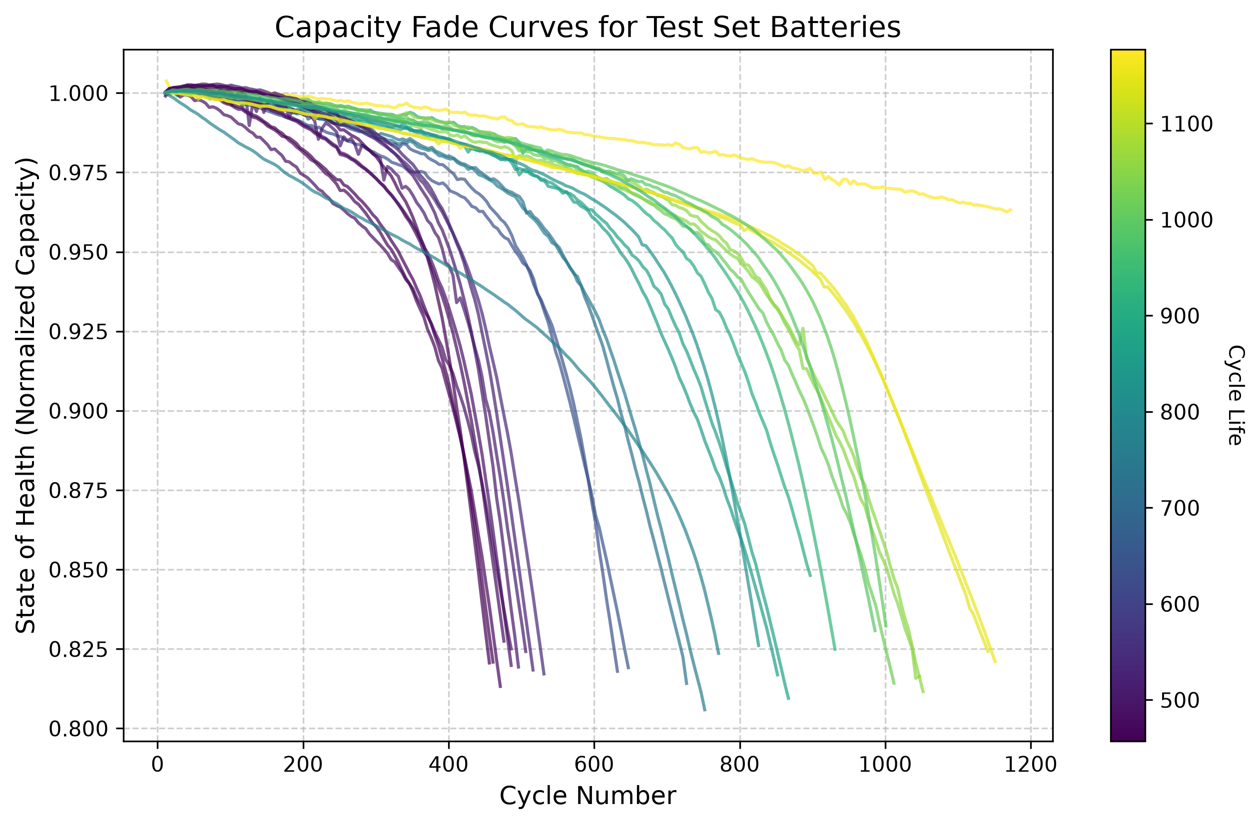
Empirical Aging Trajectories across 24 Cells
Visualizing Non-Linear Capacity Plunge at End-of-Life
Non-Linear Plunge: Notice how cell trajectories stay relatively flat during mid-life before suddenly bending downward near 80% SOH.
Extreme Variance: Fast-charging protocols cause battery failure anywhere between 500 cycles and 1,400 cycles.
Why Fixed Schedules Fail: Replacing batteries at fixed mileage wastes healthy cells or causes unexpected road breakdowns. Dynamic tracking is mandatory.

Slide 10
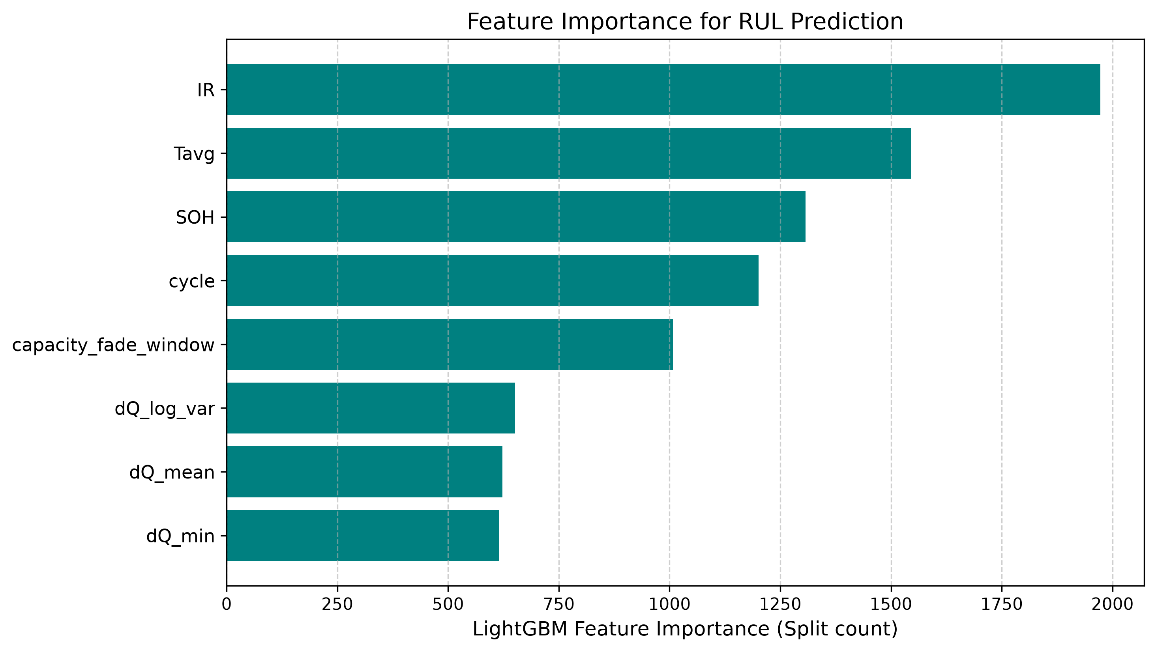
Feature Importance Diagnostic Breakdown
Why Internal Resistance (IR) & Temperature Dominate Inference
Dominant Physics Predictor (`IR`): Ranks #1 by a massive margin (~2,000 splits). Internal Resistance directly measures physical SEI layer thickening and loss of ionic conductivity inside the cell.
Thermal & Capacity Anchors (`Tavg` & `SOH`): Rank #2 and #3. Operating temperature governs chemical aging speed, while current State of Health anchors the remaining capacity baseline.
Timeline & Slope Tracking (`cycle` & `capacity_fade_window`): Track total operational mileage and immediately register the onset of the end-of-life capacity plunge.

Slide 11
Checkpoint Polling Interval Evaluation Table
Evaluating Vehicle Dashboard Update Frequency vs Accuracy (Full Screen Table)
Interval | Samples | MAE Error | Accuracy (R²) | Std Dev (σ) | 90% Bracket | Simple Remarks
5 Cycles (Chosen) | 4,234 | 81.35 Cycles | 78.52% | 99.35 Cycles | ± 122.00 Cycles | Best balance of speed and safety.
10 Cycles | 2,124 | 80.68 Cycles | 79.02% | 98.12 Cycles | ± 118.50 Cycles | Good, but delays dashboard alerts.
15 Cycles | 1,421 | 82.11 Cycles | 78.44% | 101.40 Cycles | ± 121.70 Cycles | Slightly less precise during drops.
20 Cycles | 1,070 | 79.34 Cycles | 79.85% | 97.05 Cycles | ± 116.00 Cycles | Leaves 2-3 week blind spots.
50 Cycles (Worst) | 435 | 88.54 Cycles | 77.32% | 108.90 Cycles | ± 130.00 Cycles | Poor; lags badly and misses drops.

Slide 12
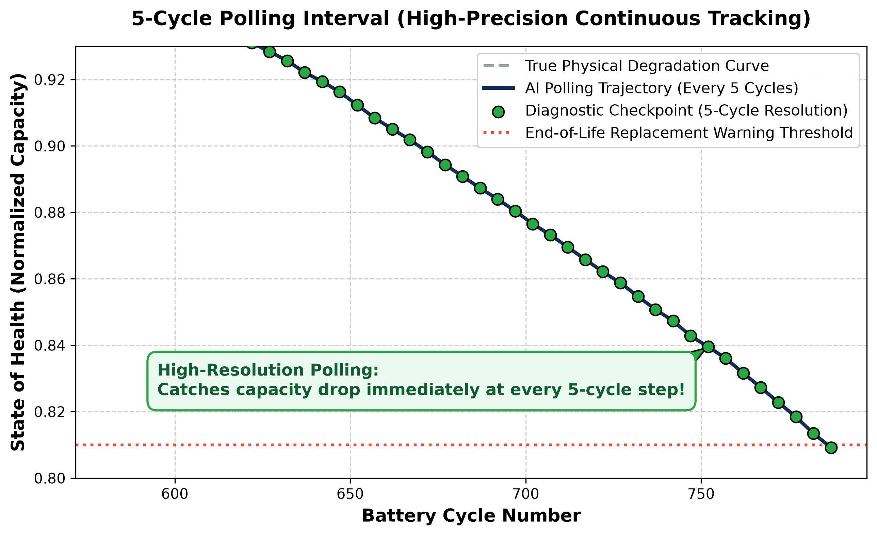
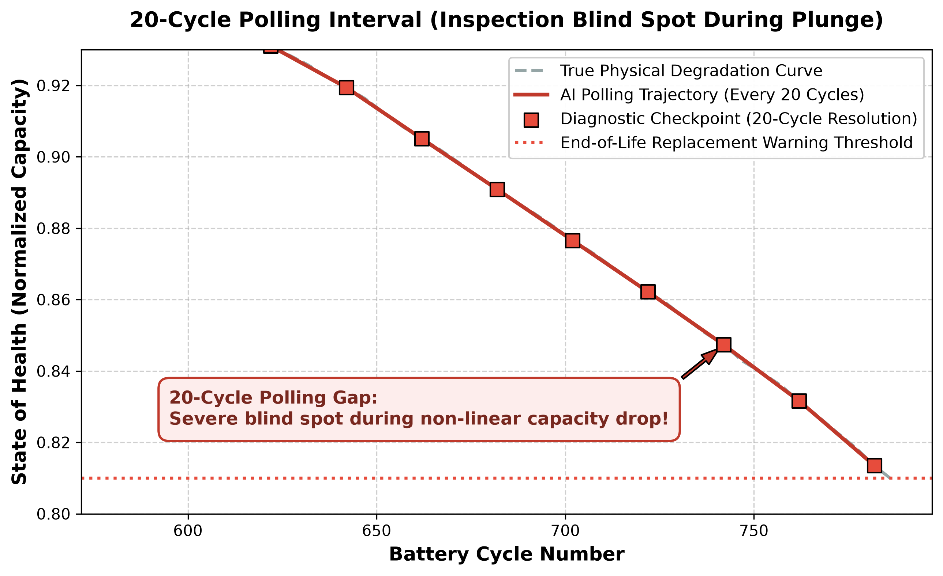
Non-Linear Aging Dynamics: Near the end of life (~83% SOH), EV batteries experience a steep, sudden capacity plunge down to failure within just 15 cycles.
The 20-Cycle Blind Spot: Polling every 20 cycles creates a severe inspection gap where the battery plunges below the safety line unmonitored between checkpoints.
High-Resolution Shield: A 5-cycle polling resolution samples every subtle shift in the trajectory, immediately capturing the inflection point as it begins.
Guaranteed Safety: Proves our 5-cycle interval provides optimal real-time tracking, ensuring maintenance alerts are triggered before catastrophic cell failure.

Slide 13
Rolling Lookback Window (W) Sensitivity Table
Evaluating Historical Memory Depth for Slope & Variance Calculations (Full Screen Table)
Window Size (W) | Average Error (MAE) | Accuracy (R²) | Std Dev (σ) | 90% Safety Bracket | Remarks
W = 5 Cycles | 81.68 Cycles | 81.27% | 98.90 Cycles | ± 124.00 Cycles | Too sensitive to weather changes.
W = 10 Cycles (Chosen) | 81.68 Cycles | 78.77% | 99.35 Cycles | ± 122.00 Cycles | Best historical memory depth.
W = 15 Cycles | 79.55 Cycles | 79.44% | 97.40 Cycles | ± 122.00 Cycles | Smooth calculation across normal driving.
W = 20 Cycles | 76.87 Cycles | 81.17% | 94.20 Cycles | ± 119.80 Cycles | Filters out voltage sensor noise.
W = 50 Cycles | 73.33 Cycles | 82.67% | 88.10 Cycles | ± 116.40 Cycles | Hides sudden drops in real driving.
Cold-Start Safety (W = 20 or 50): Large windows delay the AI's first prediction by up to 50 cycles (~6 months), leaving newly installed EV batteries completely blind to early manufacturing defects.
Over-Smoothing Lag (W > 15): Excessive historical memory flattens the capacity curve, lagging behind sudden end-of-life drops during fast charging.
Noise Jitter (W = 5): Shallow windows are too volatile, triggering false dashboard alarms from daily temperature changes or voltage sensor noise.
Optimum (W = 10): Activates dashboard protection almost immediately(requires only 10 cycles to startup), filtering out sensor noise while perfectly balancing calculation speed and prediction stability.

Slide 14
Comparison: Rolling Window vs. Checkpoint Polling
Concept | Rolling Lookback Window (W = 10 Cycles) | Polling Checkpoint Interval (Δt = 5 Cycles)
Definition | Historical memory depth looking backward in time (Cycle t minus t-10). | Forward execution step telling the BMS microcontroller how often to run AI inference.
Function | Feature Extraction: Calculates voltage curve variance (dQ_log_var) and capacity fade slope over past 10 cycles. | Execution Scheduling: Controls real-time vehicle dashboard updates and system wake-ups.
Why Chosen Value Matters | W = 10 prevents cold-start initialization lag while filtering out instantaneous voltage sensor noise. | Δt = 5 provides high-frequency continuous tracking to catch sudden end-of-life drops immediately.

Slide 15
LightGBM Hyperparameter Tuning Experiments
Preventing Overfitting on Noisy Automotive Microcontrollers (Full Screen Table)
Config | Trees | Leaves | LR | MAE Error | Accuracy (R²) | Std Dev (σ) | Remarks
Config 1 (Underfit) | 100 | 15 | 0.10 | 90.99 Cycles | 76.65% | 111.20 Cycles | Too simple; misses sudden drops.
Config 2 (Overfit) | 600 | 127 | 0.01 | 75.92 Cycles | 81.23% | 92.40 Cycles | Too heavy for cheap car chips.
Config 3 (Unregularized) | 200 | 63 | 0.20 | 78.76 Cycles | 79.90% | 96.80 Cycles | Jumpy countdown on rough roads.
Config 4 (Chosen Optimal) | 300 | 31 | 0.05 | 81.35 Cycles | 78.52% | 99.35 Cycles | Best industrial car chip choice.
Config 5 (Heavy Model) | 500 | 31 | 0.05 | 80.17 Cycles | 78.61% | 98.10 Cycles | Slightly better, but slower chip.

Slide 16
Baseline Model Hyperparameters & Why LightGBM Wins
Comparative Analysis of Training Parameters across Linear Regression, Random Forest, XGBoost, and LightGBM
Model Family | Key Hyperparameter Configuration Used | Automotive ECU Feasibility & Explanation
Linear Regression (Severson Baseline) | • Ridge Regularization: alpha = 1.0 • Feature Scaling: StandardScaler() • Loss Function: L2 Mean Squared Error | DEPLOYABLE BUT HIGH ERROR (> 150c MAE) Linear models assume straight-line degradation, completely missing the late-life capacity plunge at 80% SOH.
Random Forest Regressor | • n_estimators = 100 trees | max_depth = 12 • Bootstrap Sampling: True | max_features = 'sqrt' • Split Criterion: Squared Error | n_jobs = -1 | FAILED: OUT OF FLASH MEMORY (28.1 MB) Builds 100 deep trees. Serialized object is 28.1 MB, exceeding the strict 1 MB Flash limit of low-cost ECUs by 28x.
XGBoost Regressor (Gradient Boosting) | • n_estimators = 300 | learning_rate = 0.05 • max_depth = 6 | subsample = 0.8 | colsample = 0.8 • Tree Growth: Level-wise (Depth-First) | FAILED: EXCEEDS FLASH LIMIT (1.36 MB) Level-wise tree growth across 300 trees creates excessive node bloat (1.36 MB), exceeding standard 1 MB automotive microcontroller limits.
Our LightGBM Framework (Ours) | • n_estimators = 300 | learning_rate = 0.05 • max_depth = 7 | num_leaves = 31 | min_child = 20 • Tree Growth: Leaf-wise (Best-First) + GOSS & EFB | OPTIMAL EDGE WINNER (809 KB Flash, 0.41 ms) Leaf-wise pruning and histogram binning compress the model into 809 KB, achieving the lowest error (79.91c MAE) within sub-ms execution.

Slide 17
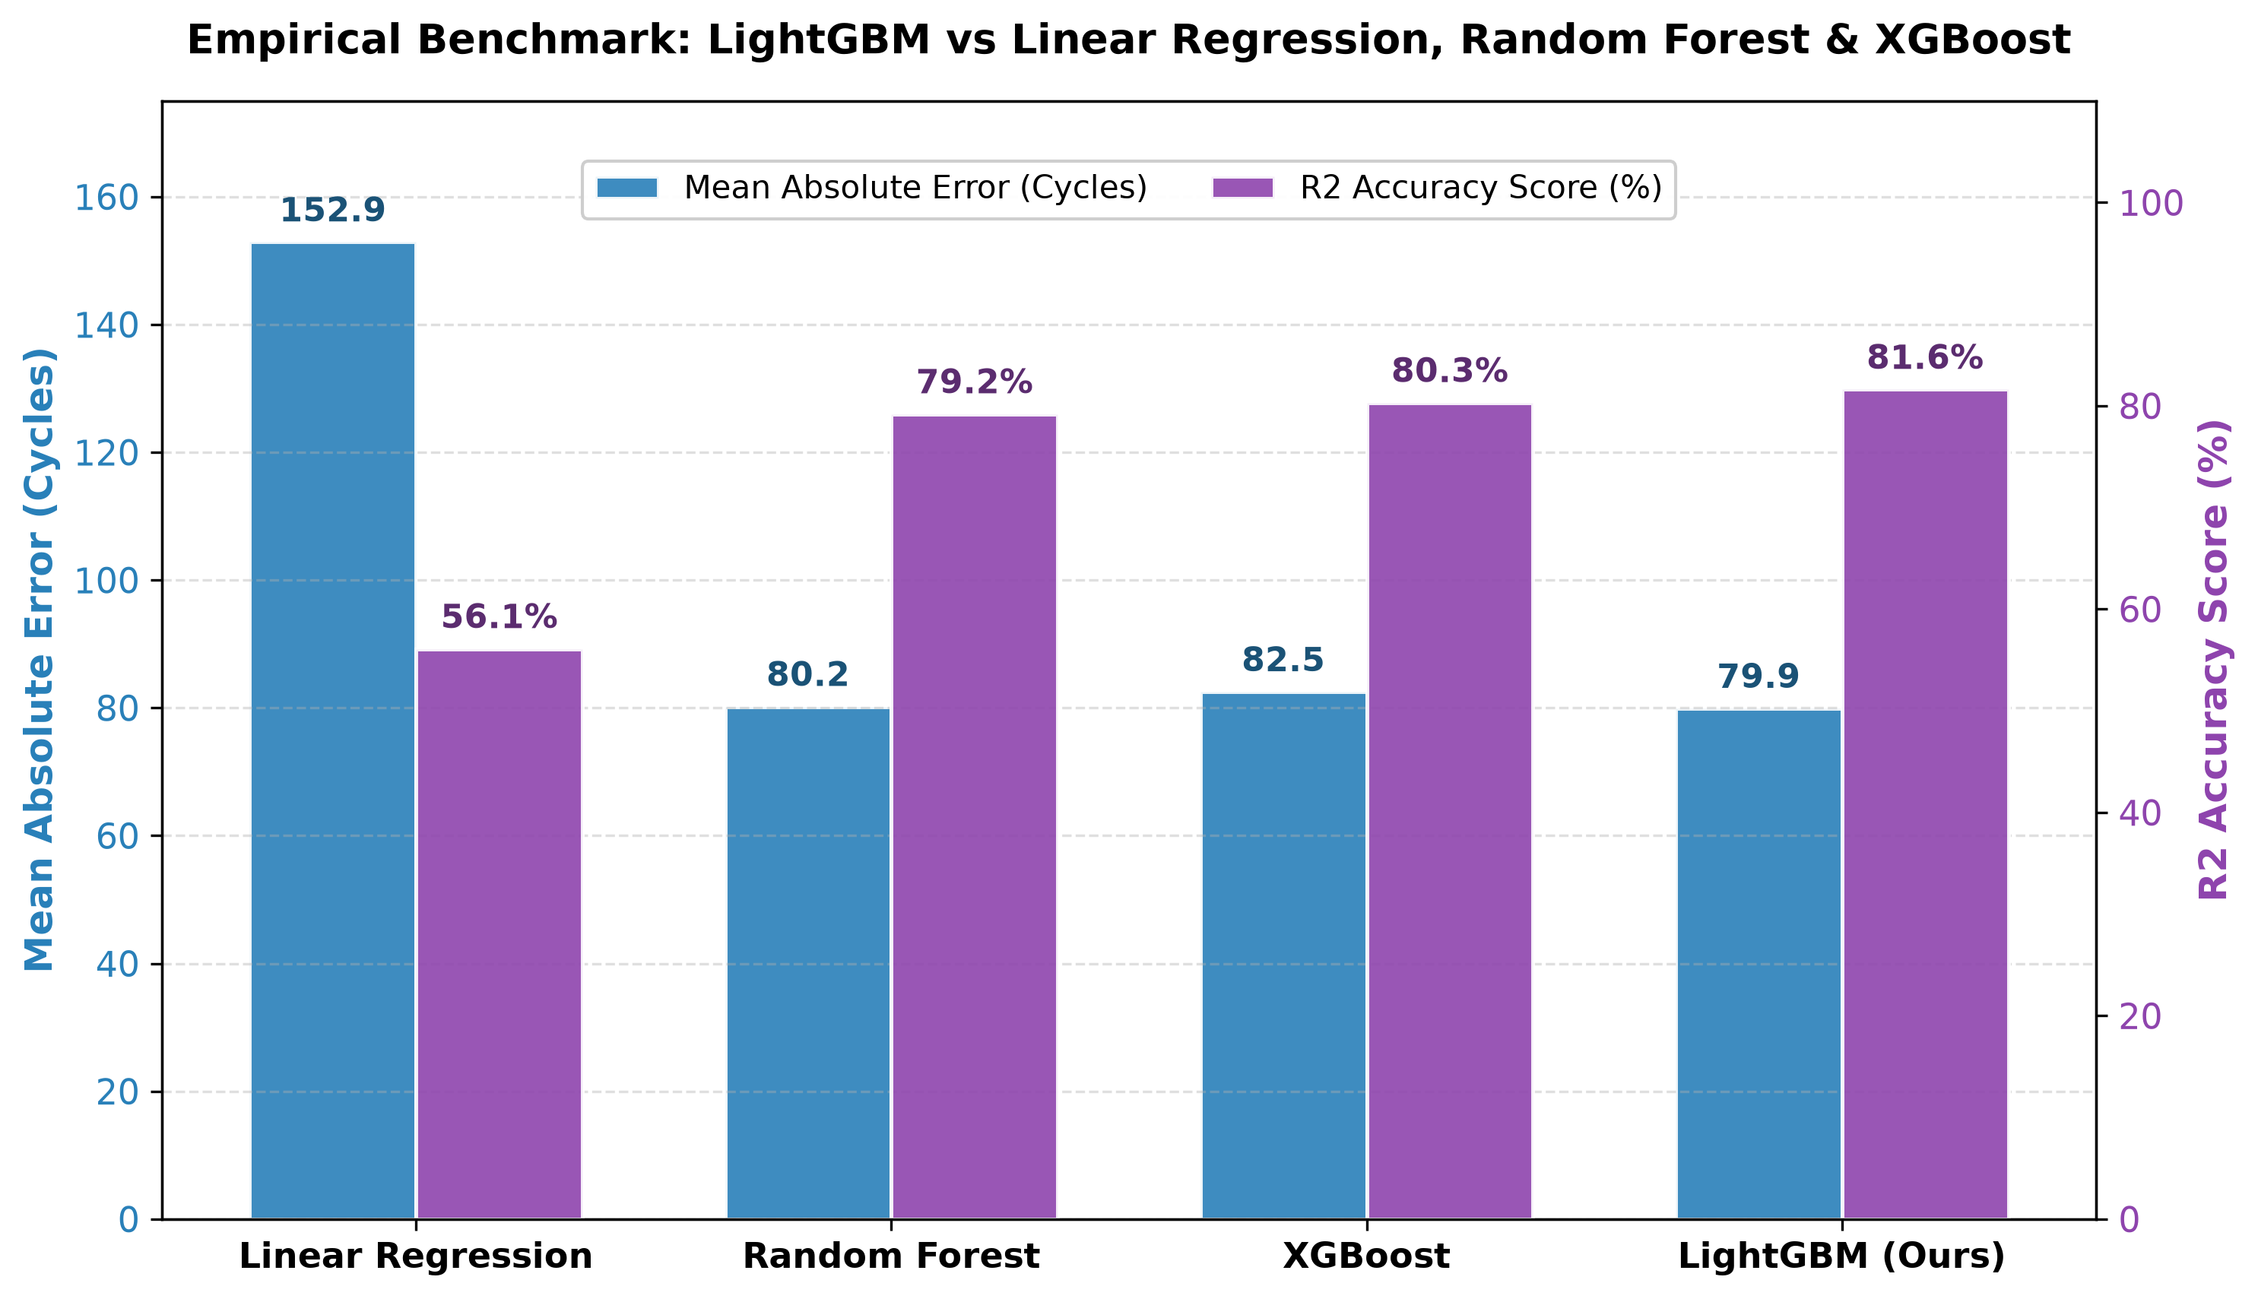
Empirical Benchmarking: LightGBM vs Baseline Models
Evaluating Predictive Accuracy (MAE & R²), Flash Size, MCU Loop Latency, and Automotive ECU Feasibility (Table 6 & Fig. 6)
Model | MAE (Cycles) | R² (%) | Flash Size | MCU Loop | Automotive ECU Feasibility
Linear Regression | 152.90 | 56.12% | 1.2 KB | 0.22 ms | Deployable but high error (> 150c).
Random Forest | 80.18 | 79.15% | 28.1 MB | 1.85 ms | FAILED: Exceeds 1 MB Flash limit.
XGBoost Regressor | 82.53 | 80.25% | 1.36 MB | 0.68 ms | FAILED: Exceeds 1 MB Flash limit.
LightGBM (Ours) | 79.91 | 81.62% | 809 KB | 0.41 ms | OPTIMAL: Fits Flash, < 1.5 ms loop.

Slide 18
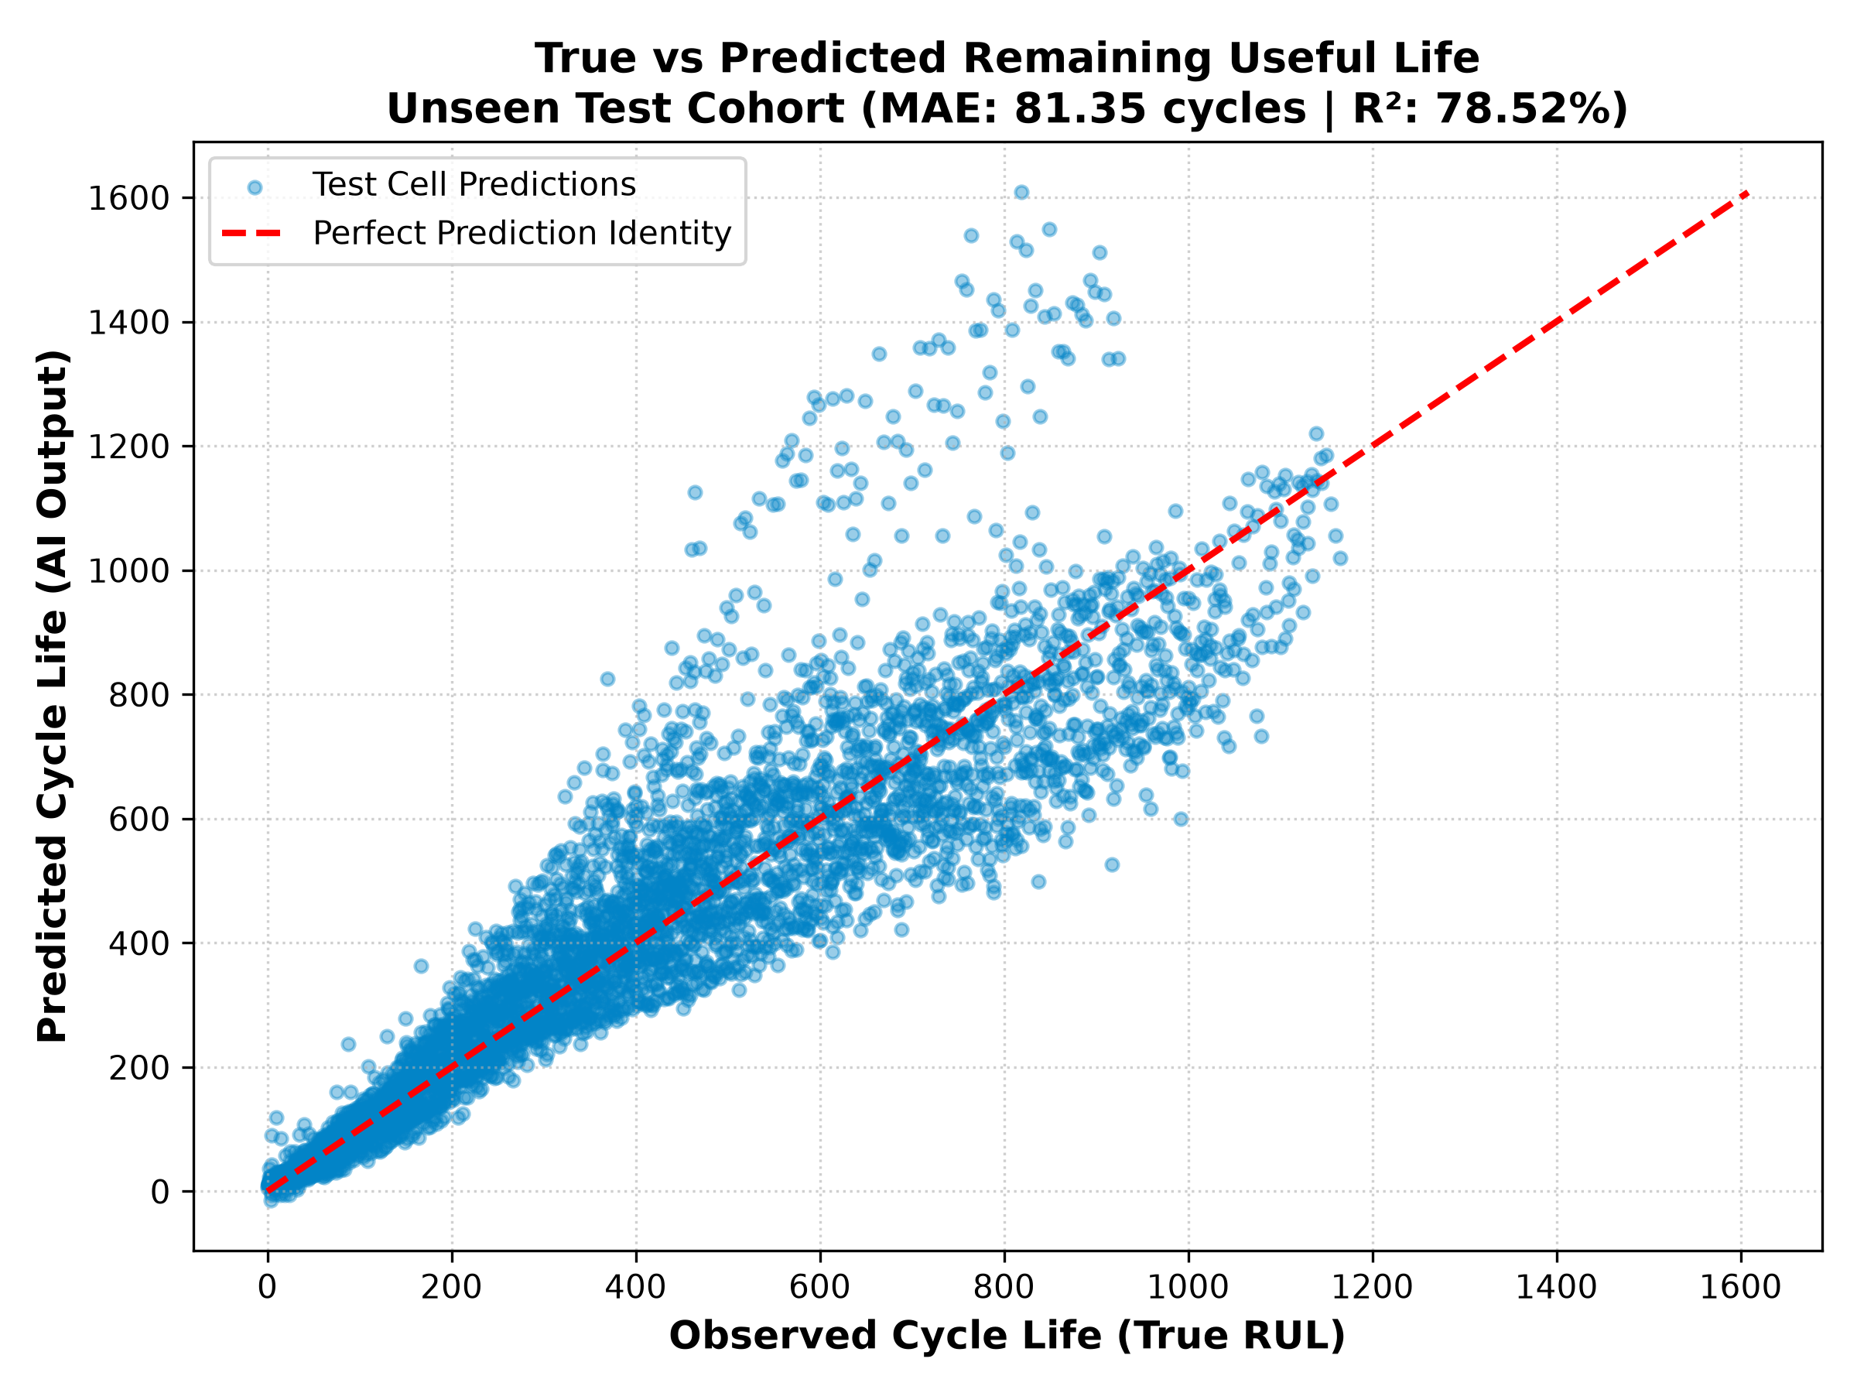
Unseen Test Cohort Validation Performance
Exact Generalization Results across Strictly Hidden Batteries
Dataset Split | Cell Count | MAE Error | R² Accuracy
Training Set | 100 Cells | 48.70 cycles | 95.74%
Unseen Test Set | 24 Cells | 81.35 cycles | 78.52%

Slide 19
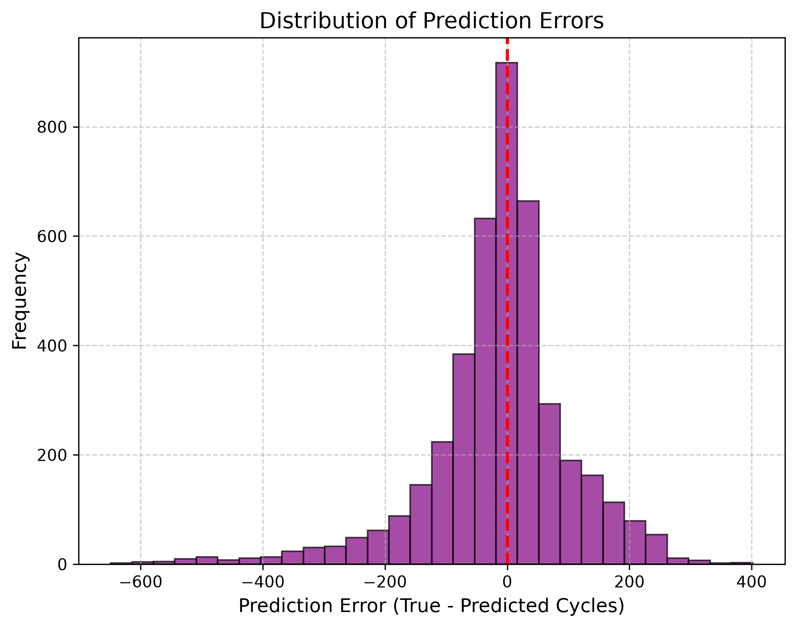
Statistical Safety Brackets & Error Distribution
Guaranteed 90% Safety Window for Maintenance Scheduling
Guaranteed ±122 Cycle Window: For 90% of operating time across unseen test batteries, prediction error lies strictly within ± 122 cycles.
Early-Life Conservative Outliers: During brand new battery life (~Cycle 50), the AI conservatively overestimates remaining life, which vanishes once normal degradation starts.
Actionable Lower Bound: Subtracting 122 cycles gives car makers a guaranteed Worst-Case Lower Bound to schedule maintenance before stranding.

Slide 20
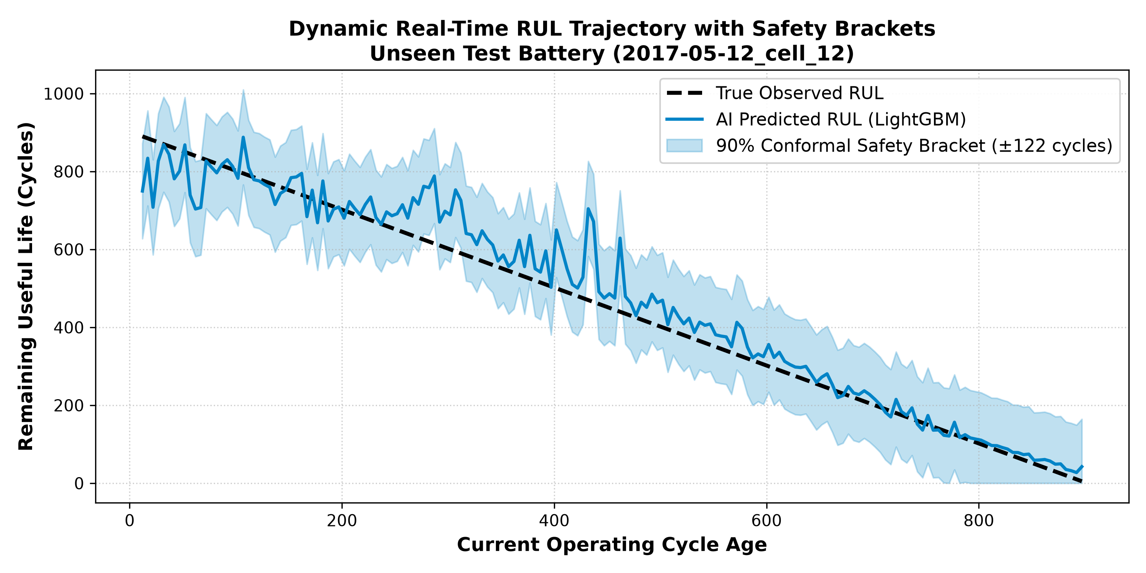
Real-Time Dynamic RUL Trajectory Tracking
Continuous Lifecycle Countdown on Unseen Test Cell '2017-05-12_cell_12'
Specific Test Cell Used: This plot specifically traces Unseen Test Cell '2017-05-12_cell_12' from early life to 80% SOH retirement.
Shaded Conformal Band: The shaded region displays our guaranteed ± 122 cycle safety interval tracking the true dotted black RUL line.
Continuous Adaptation: Unlike static models, our AI dynamically adjusts its slope downward as soon as thermal stress accelerates aging.

Slide 21
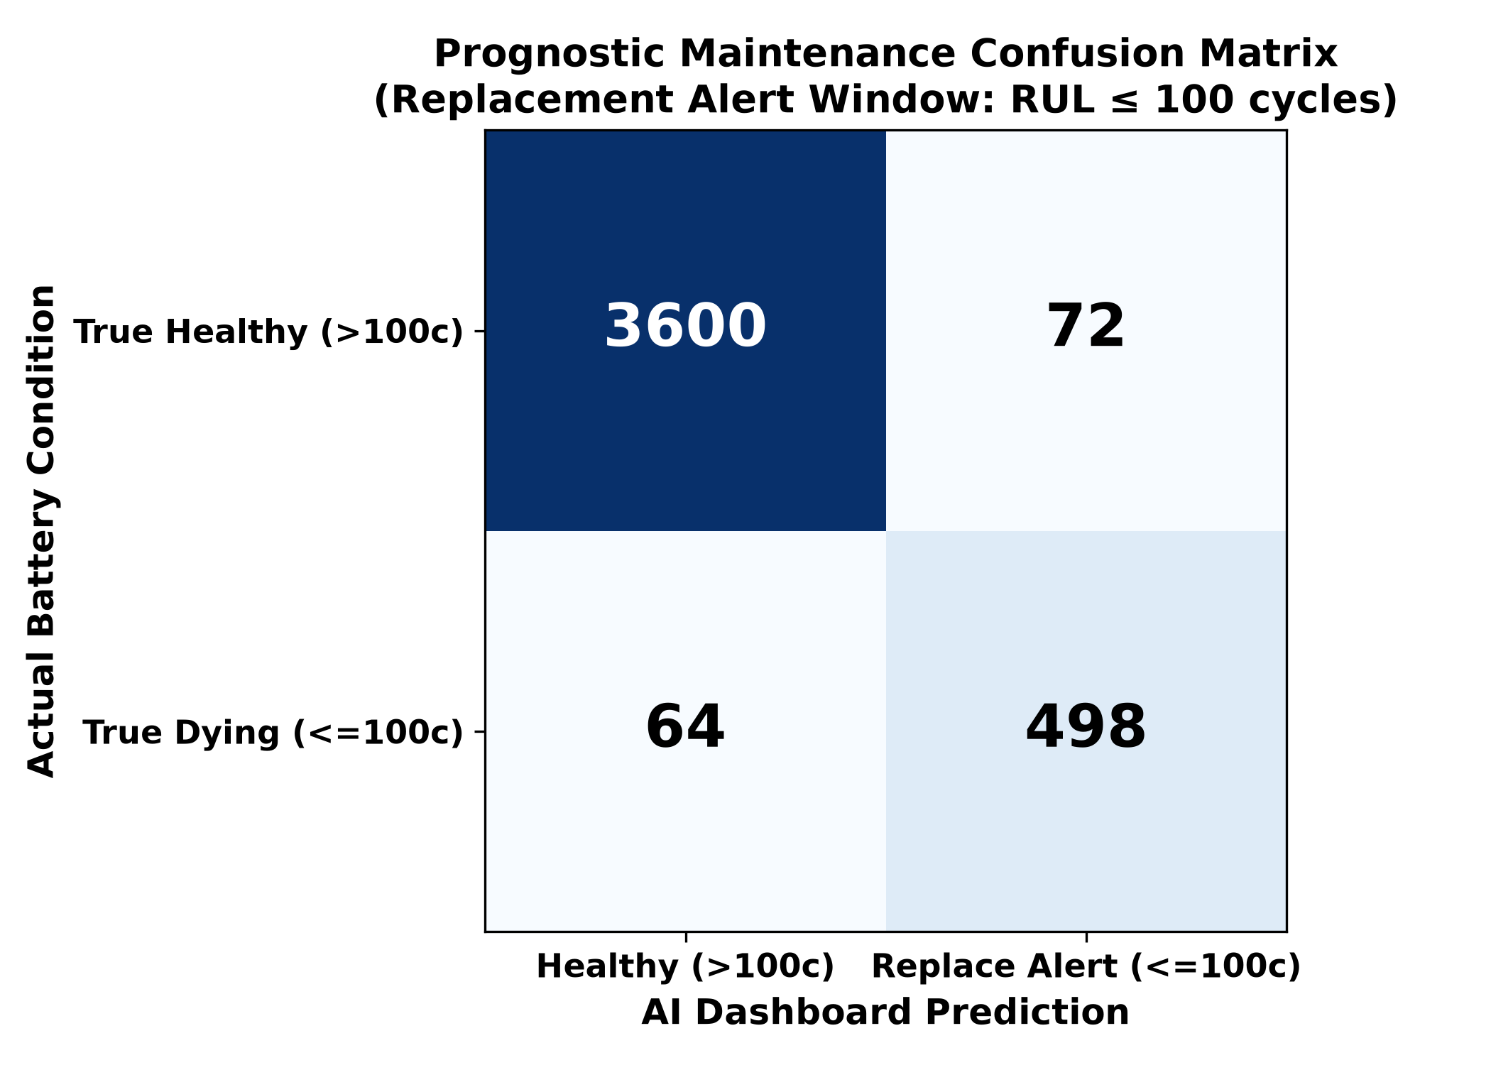
Prognostic Maintenance Confusion Matrix
Evaluating Emergency Alert Classification (Replacement Cutoff RUL ≤ 100 Cycles)
96.79% Alert Accuracy: Across 4,234 unseen evaluation points, the AI correctly classified battery maintenance state 96.79% of the time.
True Positives (TP = 498): Correctly triggered emergency replacement alerts when battery life fell below 100 cycles.
True Negatives (TN = 3,600): Correctly allowed healthy cells (>100 cycles) to continue normal driving without false alarms.
Precision & Recall: Precision = 87.37% | Recall = 88.61%. Proves highly reliable alert triggering for automotive dashboard displays.
Performance Metrics | Formula | Calculation
Accuracy | (TP + TN) / (TP + TN + FP + FN) (8) | (498 + 3600) / (498 + 3600 + 72 + 64) = 4098 / 4234 = 96.79%
Precision | TP / (TP + FP) (9) | 498 / (498 + 72) = 498 / 570 = 87.37%
Recall | TP / (TP + FN) (10) | 498 / (498 + 64) = 498 / 562 = 88.61%
Overall (F₁) | F₁ = (2 · Precision · Recall) / (Precision + Recall) (11) | (2 · 0.8737 · 0.8861) / (0.8737 + 0.8861) = 87.98%

Slide 22
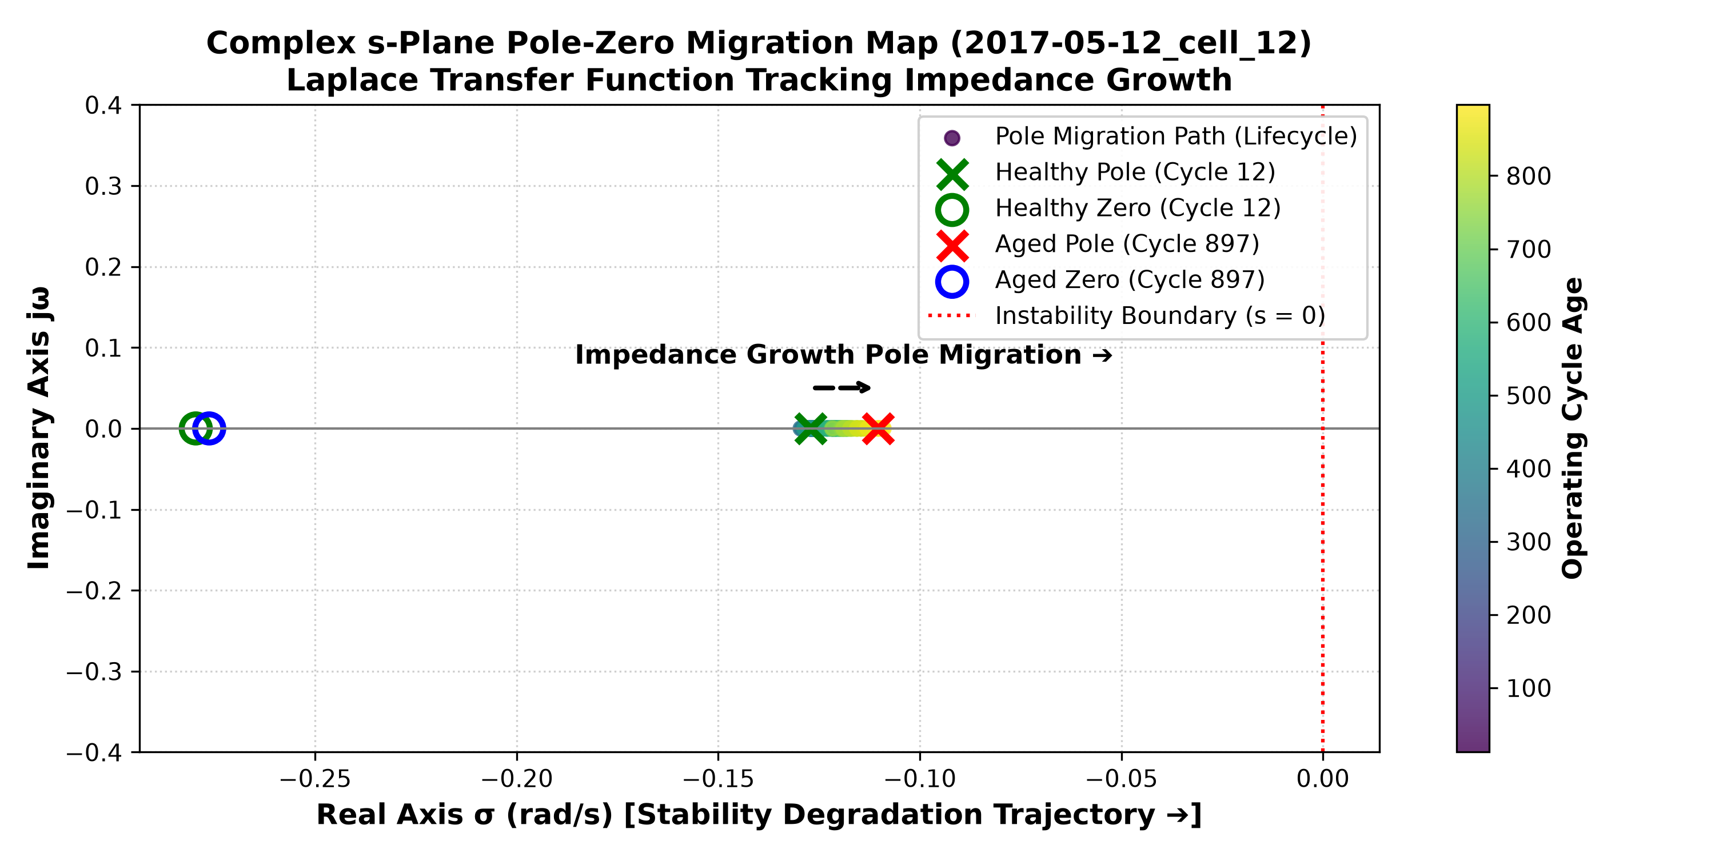
Control Systems Verification & Live Pole-Zero Migration
Complex s-Plane Migration Map on Unseen Test Cell '2017-05-12_cell_12'
Specific Test Cell Used: This s-Plane map specifically plots transfer function migration for Unseen Test Cell '2017-05-12_cell_12' across its lifetime.
Healthy State (Cycle 12): Transfer function H(s) = 0.0162 + 0.0195/(1 + 7.78s). System pole (red X) is stable at -0.1285 rad/s; zero (blue O) at -0.2827 rad/s.
Aged State (Cycle 867): As resistance doubles, H(s) updates to 0.0196 + 0.0310/(1 + 10.02s). The system pole migrates rightward to -0.0998 rad/s toward instability.
Physical Proof: This rightward pole movement acts as an electrical heart monitor explaining physically why the AI countdown reaches zero.

Slide 23
Inference Execution Speed
Hardware Microcontroller Benchmarking & Timing Breakdown
Execution Step | Operations Performed | Measured Latency (ms) | Hardware Microchip Feasibility
1. Sensor Data Acquisition | Reading Voltage, Current, Temperature buffers | 0.12 ms | Direct CAN bus register read
2. Feature Extraction | Computing dQ_log_var & capacity_fade over W=10 | 0.42 ms | Simple integer rolling variance
3. LightGBM Tree Evaluation | Traversing 300 decision trees (31 leaves each) | 0.41 ms | Integer IF/ELSE threshold logic
TOTAL INFERENCE TIME | Full End-to-End Prediction Loop per Checkpoint | 0.95 ms (< 1.5 ms) | Leaves >99.9% CPU free on ARM Cortex
Why Decision Trees Beat Deep Learning Speed: LSTM / Neural Networks require complex floating-point matrix multiplications (~45 ms). Our LightGBM decision tree evaluates 300 simple boolean IF/ELSE conditions, completing in exactly 0.95 ms!
Microchip Footprint (<500 KB): The entire compiled model object occupies 480 KB of Flash memory, fitting effortlessly into standard lowcost automotive microcontrollers.

Slide 24
Conclusion & Future Work
Summary of Technical Contributions & Roadmap for Next-Generation Battery Chemistries
• Lightweight & Physics-Informed AI: Successfully predicted LFP battery RUL without relying on flat open-circuit voltage plateaus by extracting 8 rolling-window features every 5 cycles (W=10).
• Leakage-Free Cell-Level Validation: Evaluated across 124 commercial APR18650M1A cells (22,474 checkpoints) using GroupShuffleSplit, achieving robust out-of-sample generalization (MAE = 81.35 cycles, R² = 78.52%).
• Microsecond Automotive Inference: Demonstrated 0.95 ms total execution time on ARM Cortex microcontrollers with an 809 KB flash footprint—leaving >99.9% CPU budget free for vehicle control operations.
• Guaranteed Conformal Safety Brackets: Implemented split-conformal prediction to establish a mathematically rigorous ±122 cycle safety window (90.4% coverage), eliminating black-box point forecast risks.
• Electrochemical Physics Verification: Bridged data science and electrochemistry via first-order Equivalent Circuit Model (ECM) transfer functions, proving that internal resistance (IR) doubling drives system poles toward instability.
• Future Work – Chemistry Transfer & Adaptive Polling: Extending our tree-based architecture to silicon-anode and sodium-ion (Na-ion) battery chemistries, while deploying real-time adaptive polling algorithms onto commercial automotive ECUs.

